Slide 1

Data Challenge – Fraud detection
Junzhe Zhang
Data scientist
zhangjunzhe8868@gmail.com

Slide 2
Agenda
Introduction
Approach and Analysis
Recommendations
Summary

Slide 3
Introduction
Fraud is a problem for any bank. Fraud can take many forms, whether it is someone stealing a single credit card, to large batches of stolen credit card numbers being used on the web, or even a mass compromise of credit card numbers stolen from a merchant via tools like credit card skimming devices.
This project need to build a binary classification model (also can report the probability of fraudulent) to detect the fraud at the transaction level.

Slide 4
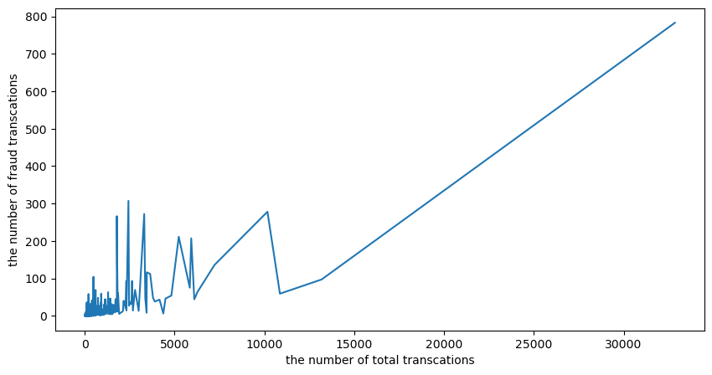
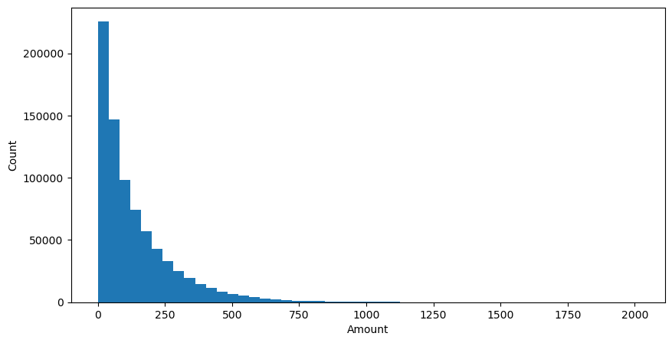
Approach and Analysis
Data exploration
There label of fraud and non-fraud are imbalanced (fraud transaction takes only 1.579%).
Card present transaction has less fraud.
Mismatched CVV and expiration date has no fraud because the transaction cannot be processed.
Some accounts have significantly more fraudulent transactions than others.
Most of transaction is a small amount transaction.

Slide 5
Approach and Analysis
Data cleaning
Handle the missing value and outlier
Scale the continuous feature
Encode the categorical feature
Dropped off the variables that a major category took more than 90%
Converted time data to a time data format
Feature engineering
Find or make the features that contributes to the classification, such as fraudRatio, mcc_ratio, mnc_ratio
Check if it is imbalanced data
Check the distribution of the predictor variable
Predictive model
75% training and 25% testing
Random oversampling of minority and random undersampling of majority in training data
Grid search to tune the hyperparameter
Model optimization (kicked out the less importance features)
Model evaluation
Metrics: auc score, precision-recall curve, precision, false alarm rate, and accuracy score
precision and false alarm rate are important since a false alarm can lead to a bad customer experience but a missing can be detected by other models
Notes:
.

Slide 6
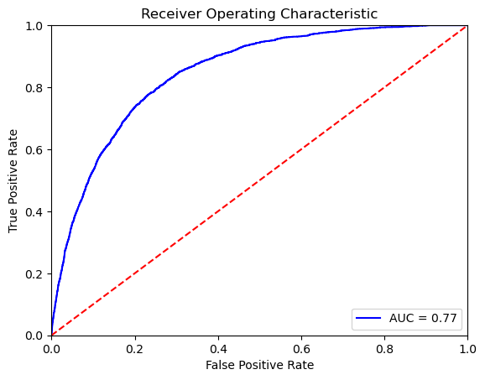
Approach and Analysis
Result
availableMoney, posEntryMode, currentBalance, amount, fraudRatio, mcc_ratio, mnc_ratio are the predictor variables
Random oversampling of minority was applied for solving the imbalanced data
The performance of random forest is better than decision tree and logistic regression
The grid search found the n_estimators = 300, max_depth=9, max_leaf_nodes=18 of Random forest has the best performance: auc:0.778, Precision:0.996 False Alarm Rate:0.176

Slide 7
Recommendations
Model deployment
Future development
When deploying this model, a blacklist of user or shopper can be added before running this model.
This model can report the probability of the fraud, which can be the input for the following model.
When the potential fraud was detected, it need a review system to review the transaction or a message broker to alert the user to check.
Some anomaly detection methods can be tried in this study, such as Local Outlier Factor and Isolation Forest.
For imbalance data, TomekLinks and SMOTE methods can be tried for undersampling the majority class or oversampling the minority class

Slide 8
Summary
This project need to build a binary classification model.
There are four steps for build this model: data exploration, feature engineering and data cleaning, building baseline and ML models, and model evaluation.
Next step: model implementation (big data or on-time), model monitoring, and model retrain.
This model is a starting point but need more models to work together, such as model can detect the missing fraudulent transaction from this model or the model checking for some big transactions.

Slide 9
Thank you

